Slide 1
Chapter 6
Some Continuous Probability Distributions

Slide 2
Section 6.1
Continuous Uniform Distribution

Slide 3
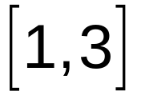
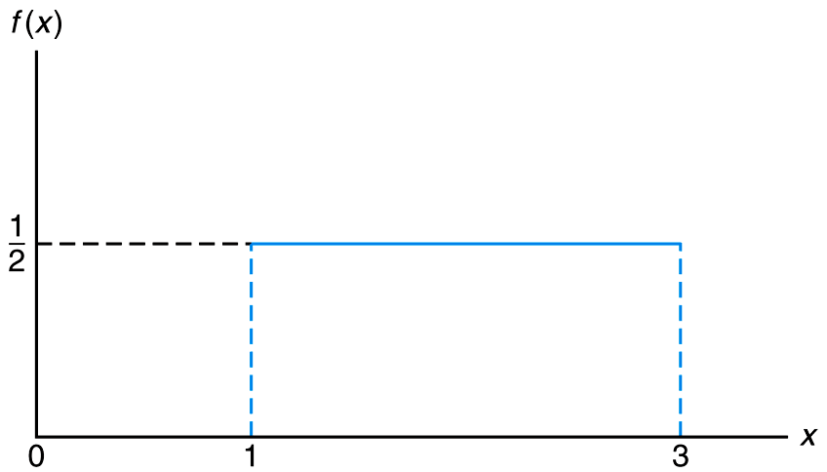
Figure 6.1 The density function for a random variable on the interval

Slide 4
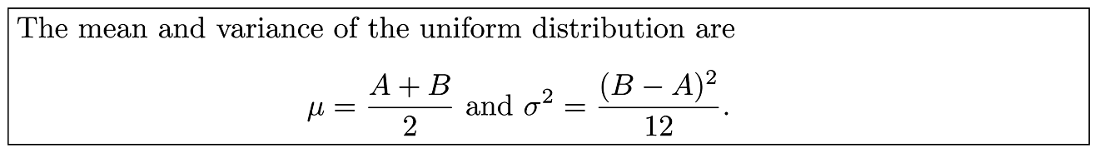
Theorem 6.1

Slide 5
Section 6.2
Normal Distribution

Slide 6
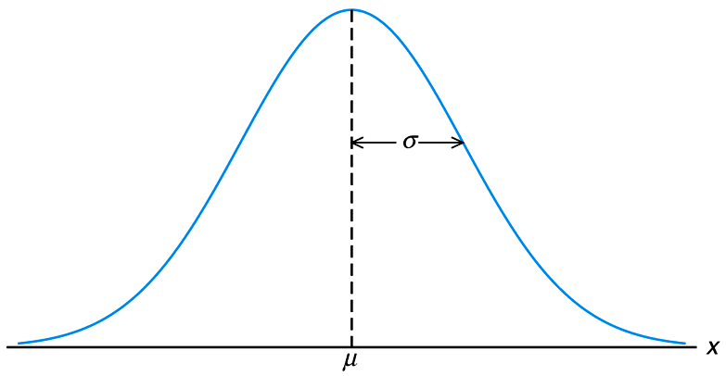
Figure 6.2 The normal curve

Slide 7
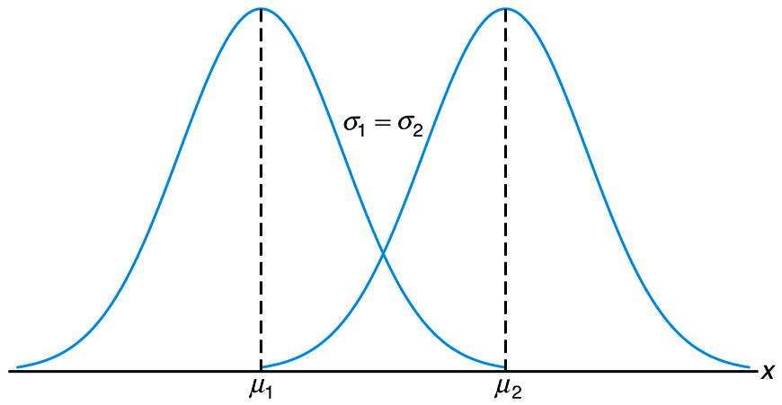
Figure 6.3 Normal curves with μ₁ < μ₂ and σ₁ = μ₂

Slide 8
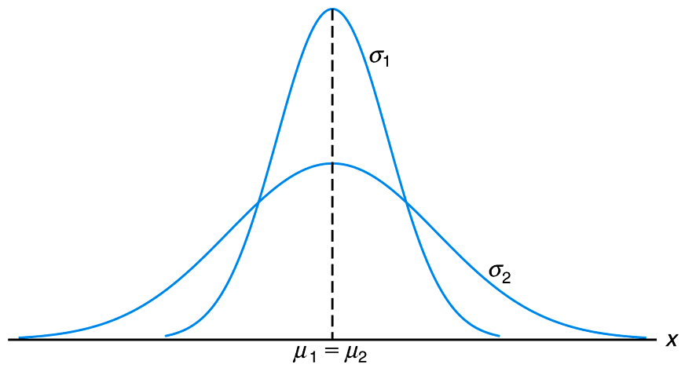
Figure 6.4 Normal curves with μ₁ = μ₂ and σ₁ < σ₂

Slide 9
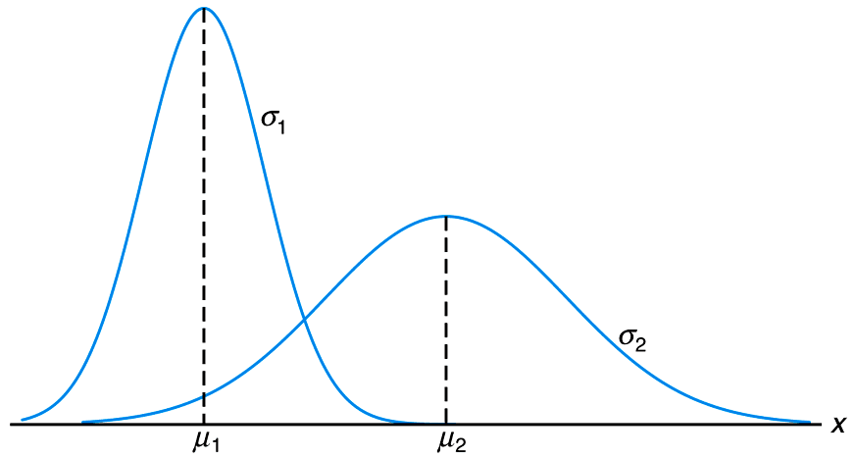
Figure 6.5 Normal curves with μ₁ < μ₂ and σ₁ < μ₂

Slide 10
Theorem 6.2

Slide 11
Section 6.3
Areas under the Normal Curve

Slide 12
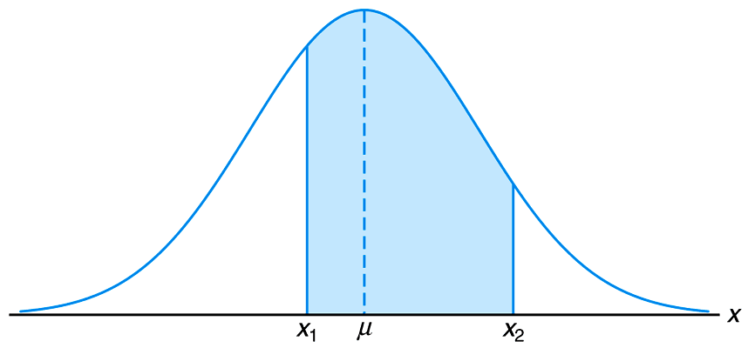
Figure 6.6 P(x₁ < X < x₂) = area of the shaded region

Slide 13
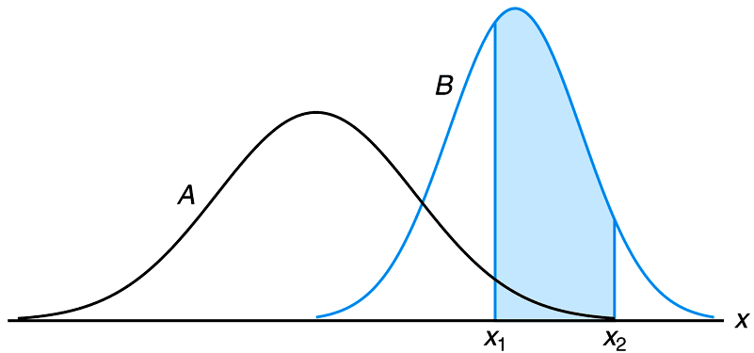
Figure 6.7 P(x₁ < X < x₂) for different normal curves

Slide 14
Definition 6.1

Slide 15
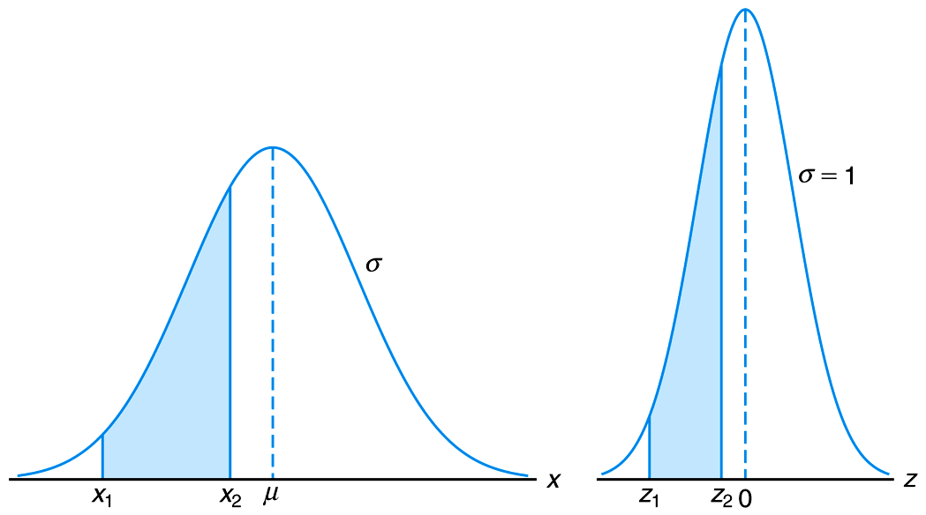
Figure 6.8 The original and transformed normal distributions

Slide 16
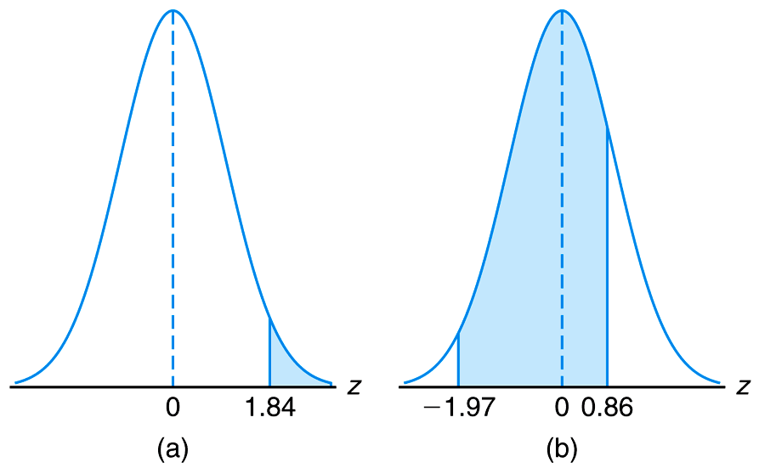
Figure 6.9 Areas for Example 6.2

Slide 17
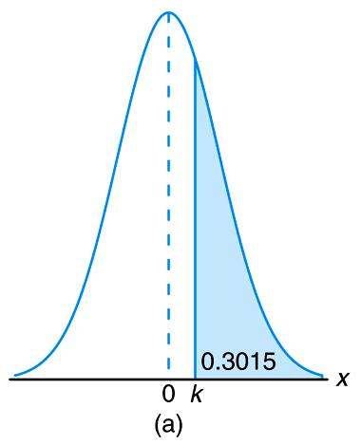
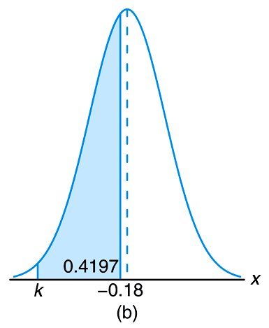
Figure 6.10 Areas for Example 6.3

Slide 18
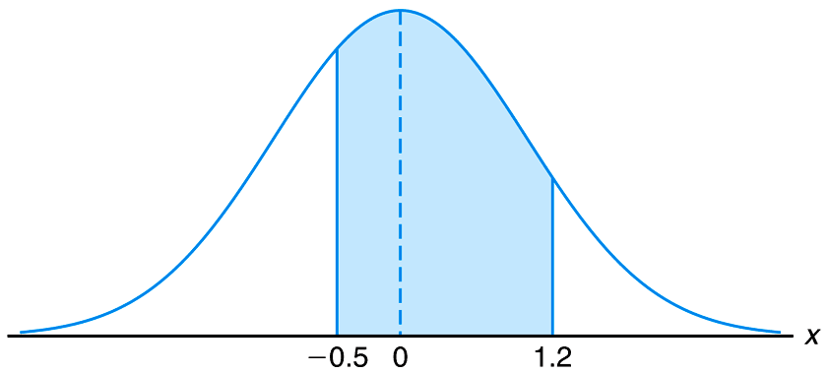
Figure 6.11 Area for Example 6.4

Slide 19
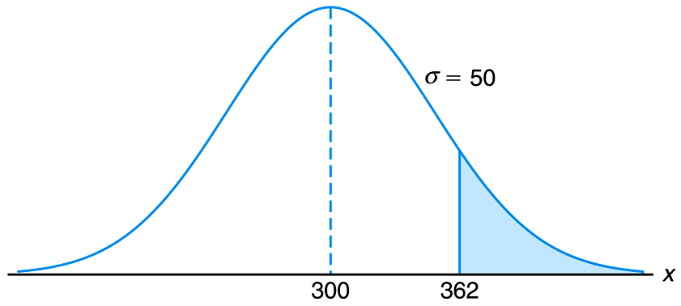
Figure 6.12 Area for Example 6.5

Slide 20
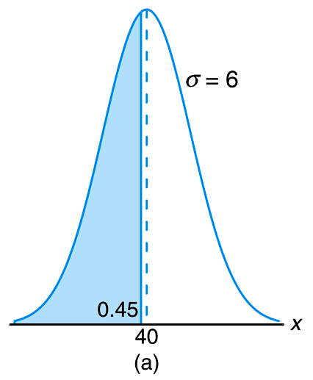
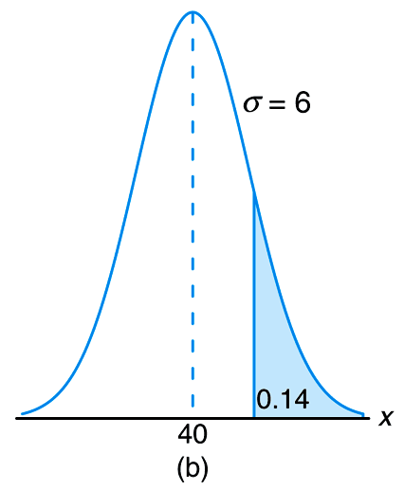
Figure 6.13 Areas for Example 6.6

Slide 21
Section 6.4
Applications of the Normal Distribution

Slide 22
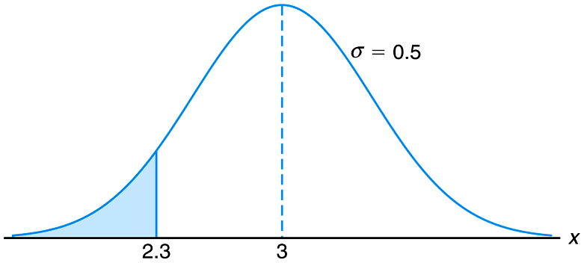
Figure 6.14 Area for Example 6.7

Slide 23
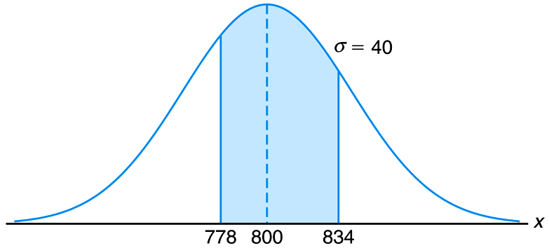
Figure 6.15 Area for Example 6.8

Slide 24
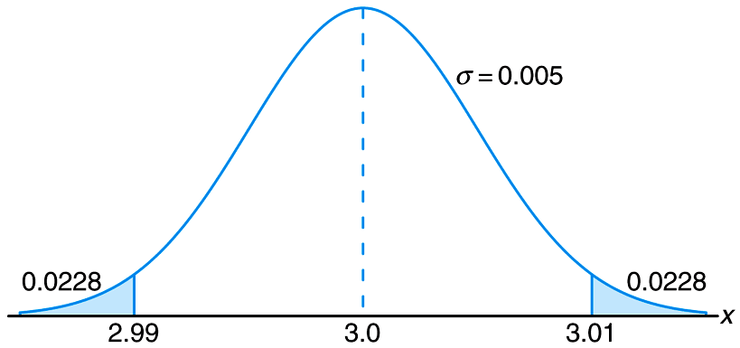
Figure 6.16 Area for Example 6.9

Slide 25
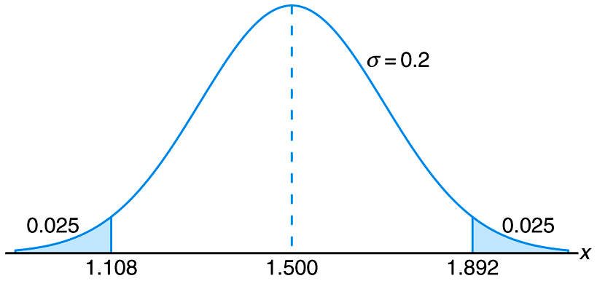
Figure 6.17 Specifications for Example 6.10

Slide 26
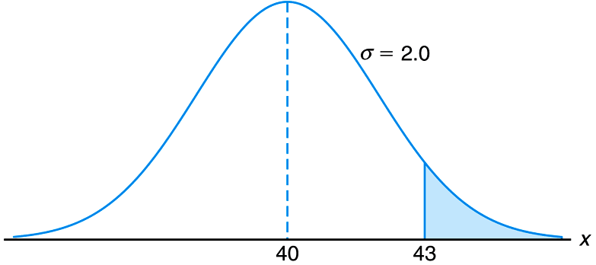
Figure 6.18 Area for Example 6.11

Slide 27
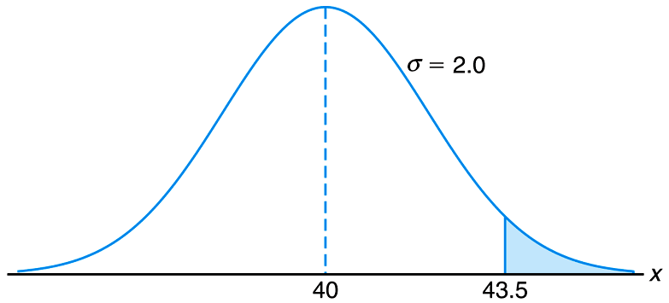
Figure 6.19 Area for Example 6.12

Slide 28
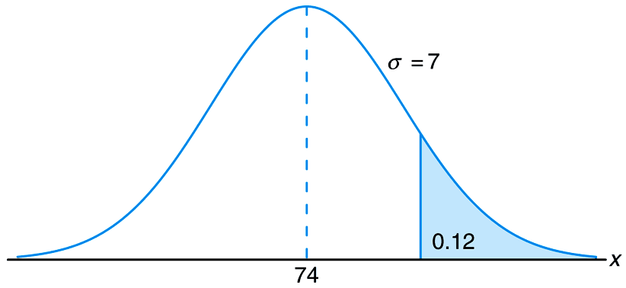
Figure 6.20 Area for Example 6.13

Slide 29
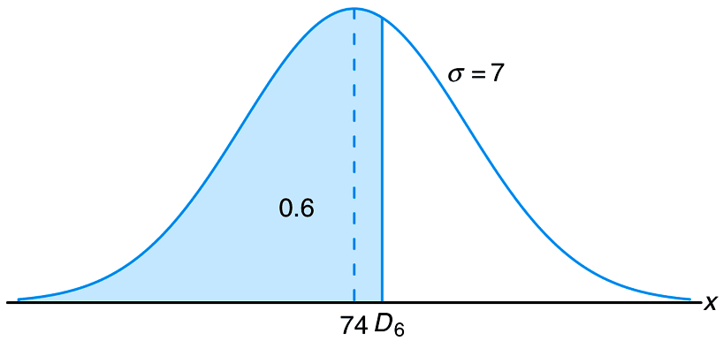
Figure 6.21 Area for Example 6.14

Slide 30
Section 6.5
Normal Approximation to the Binomial

Slide 31
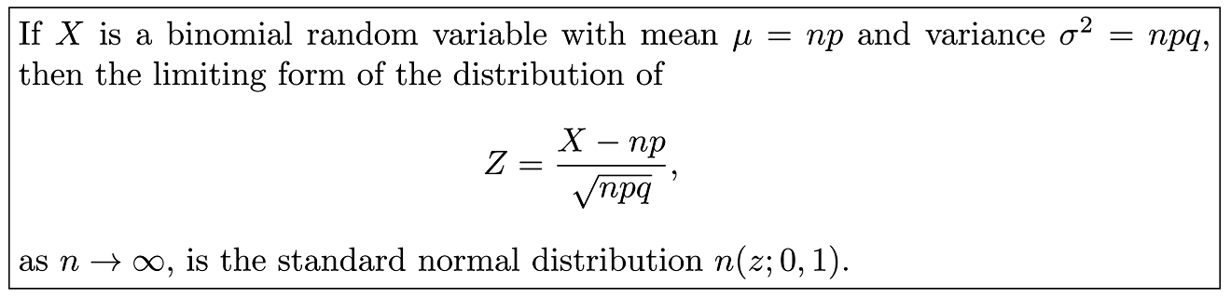
Theorem 6.3

Slide 32
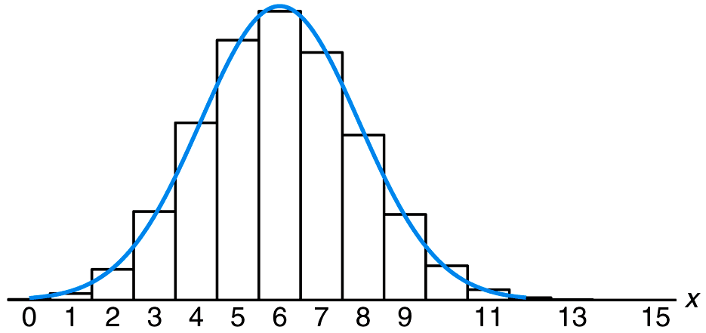
Figure 6.22 Normal approximation of b(x; 15,0.4)

Slide 33
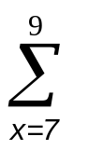
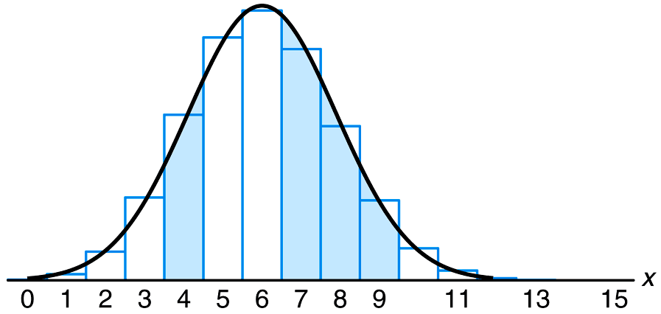
Figure 6.23 Normal approximation of b(x; 15, 0.4) and b(x; 15, 0.4)

Slide 34
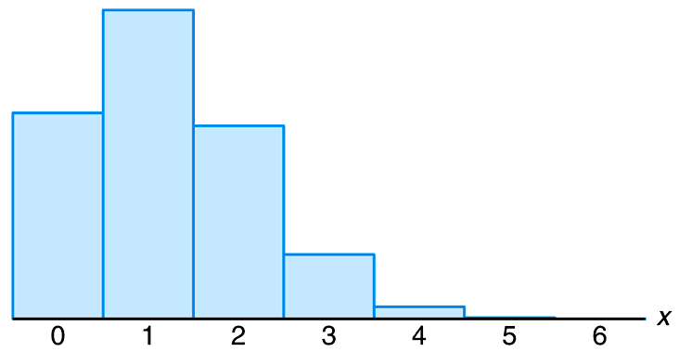
Figure 6.24 Histogram for b(x; 6, 0.2)

Slide 35
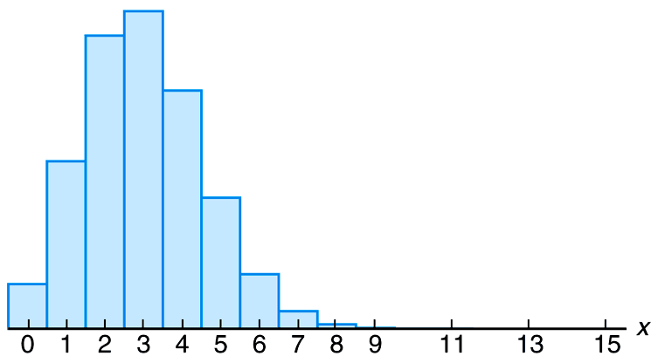
Figure 6.25 Histogram for b(x; 15, 0.2)

Slide 36
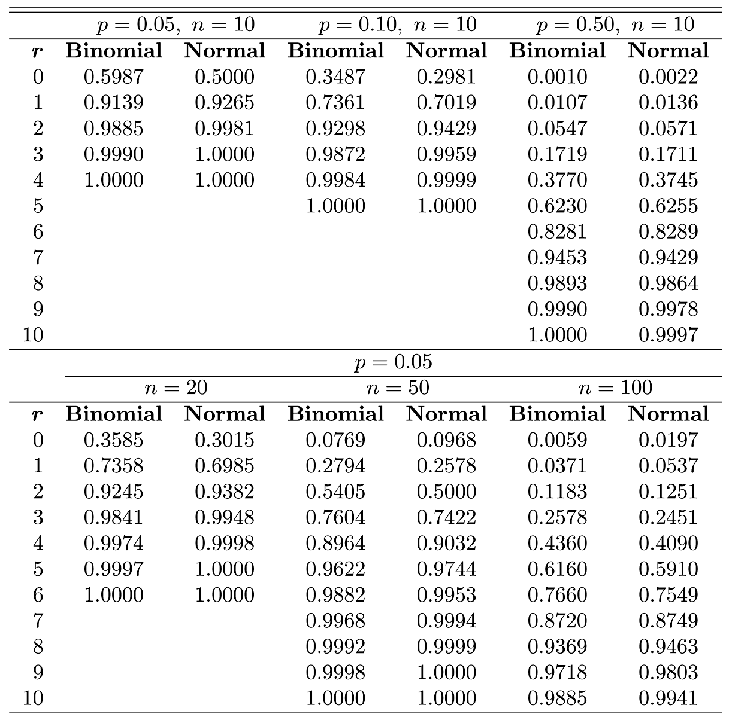
Table 6.1 Normal Approximation and True Cumulative Binomial Probabilities

Slide 37
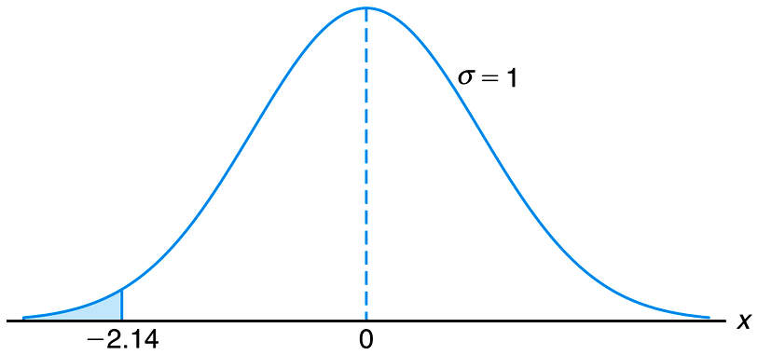
Figure 6.26 Area for Example 6.15

Slide 38
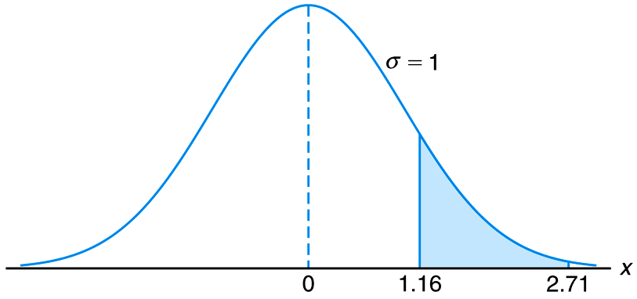
Figure 6.27 Area for Example 6.15

Slide 39
Section 6.6
Gamma and Exponential Distributions

Slide 40
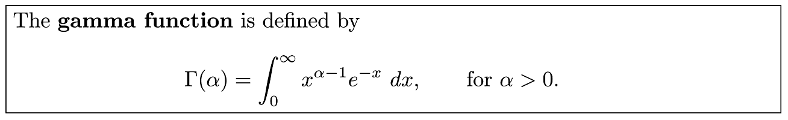
Definition 6.2

Slide 41
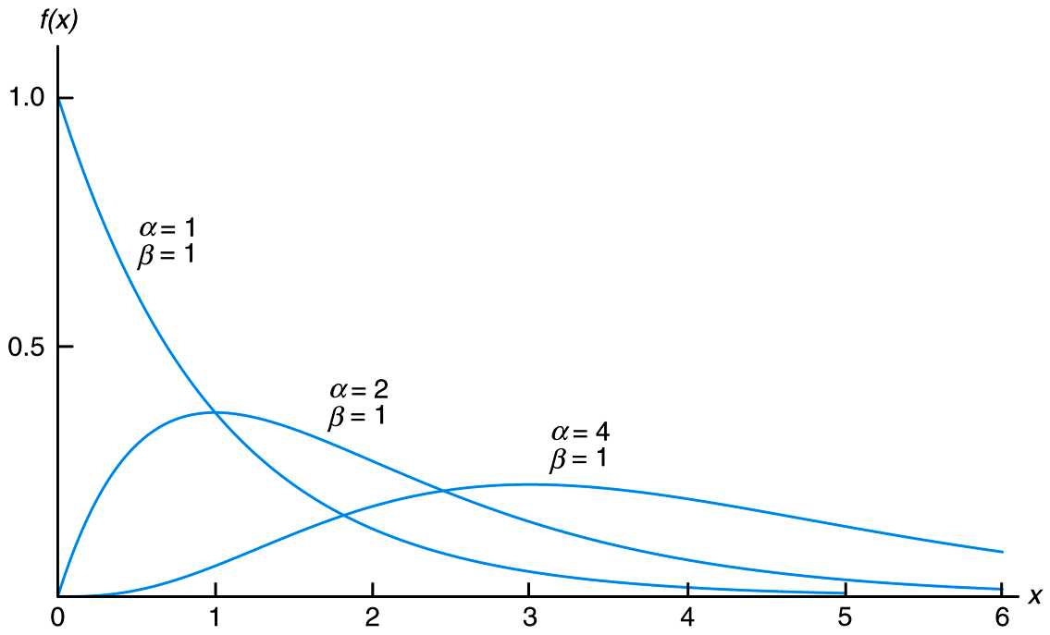
Figure 6.28 Gamma distributions

Slide 42
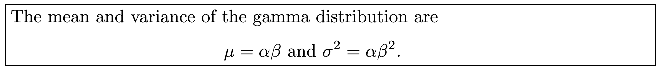
Theorem 6.4

Slide 43
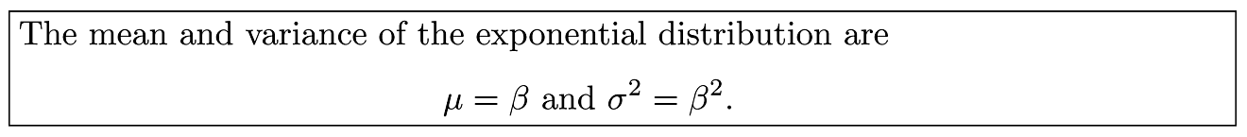
Corollary 6.1

Slide 44
Section 6.7
Chi-Squared Distributions

Slide 45
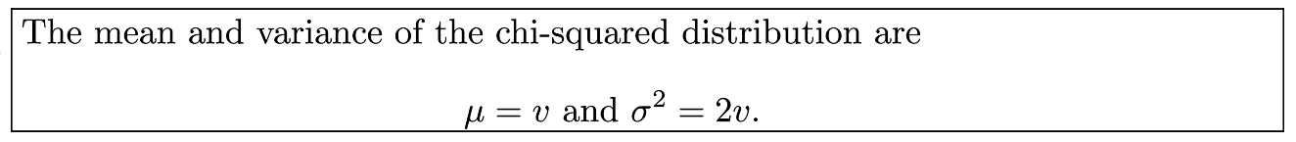
Theorem 6.5

Slide 46
Section 6.8
Beta Distribution

Slide 47
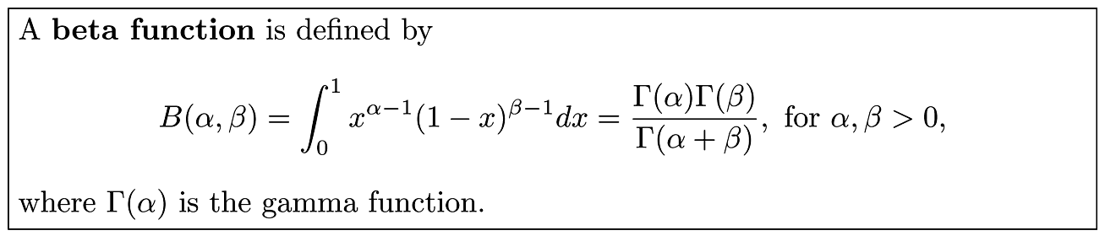
Definition 6.3

Slide 48
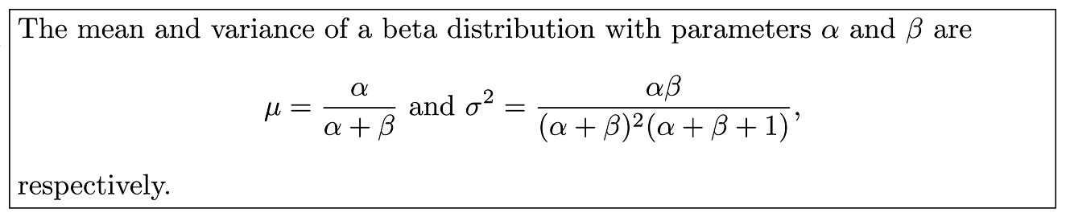
Theorem 6.6

Slide 49
Section 6.9
Lognormal Distribution

Slide 50
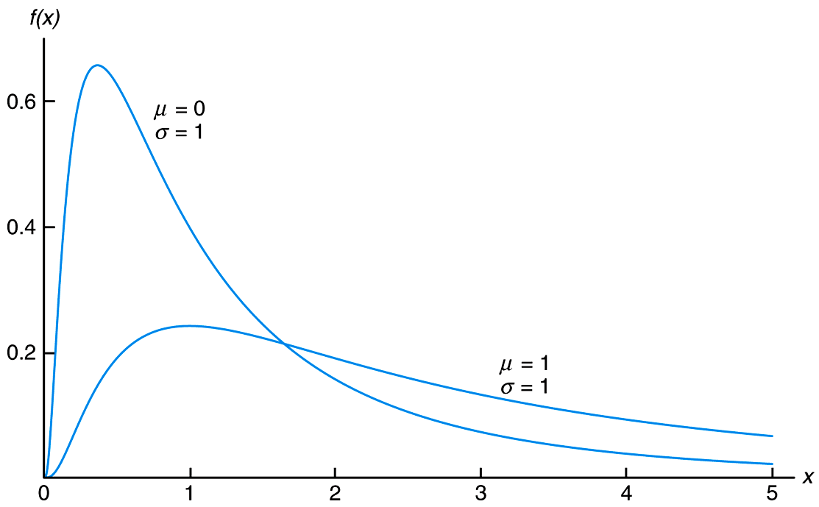
Figure 6.29 Lognormal distributions

Slide 51
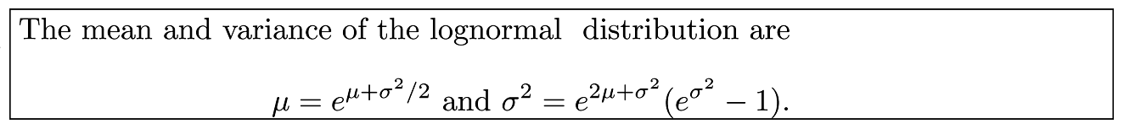
Theorem 6.7

Slide 52
Section 6.10
Weibull Distribution (Optional)

Slide 53
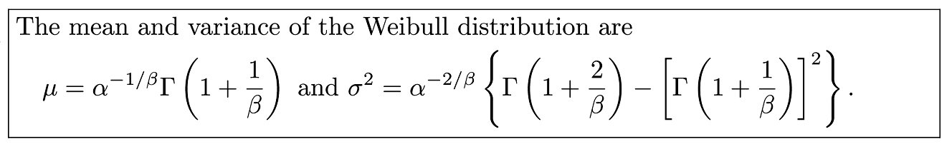
Theorem 6.8

Slide 54
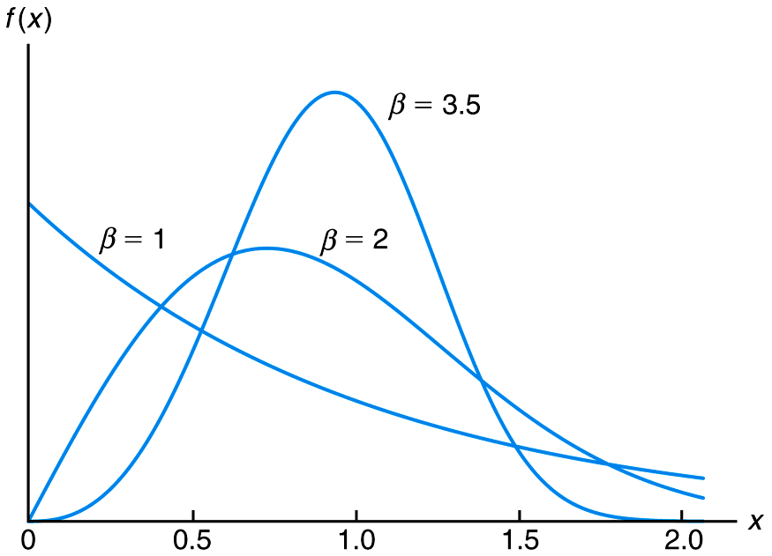
Figure 6.30 Weibull distributions (α = 1)

Slide 55
Section 6.11
Potential Misconceptions and Hazards; Relationship to Material in Other Chapters

